Slide 1



Predicting Tissue-Specific Gene Expression from Blood Using AI
Presented by
Kartika Waluyo, 1000555
Vrinda Rajendar Rajanahally, 1129446
22 October 2021
Notes:
Need to introduce the client, and the team roles

Slide 2
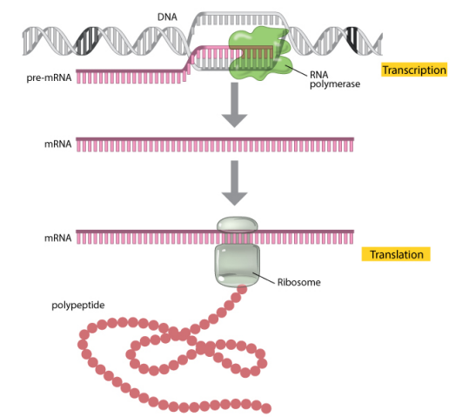
Introduction
Gene expression
Measured through RNA sequencing
Indicates the “activation level” of genes in a tissue
Used to understand disease mechanisms and assess the effectiveness and safety of treatments
protein
Image source: https://www.nature.com/
Notes:
mRNA is easier to measure (cheaper)
But the main goal is to measure protein

Slide 3
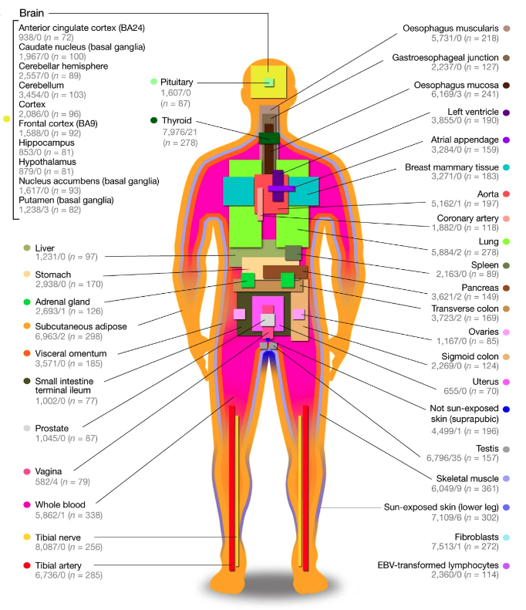

Data
The Genotype-Tissue Expression (GTEx)
Publicly available dataset containing gene expression of 54 post-mortem tissues from almost 1,000 individuals
Website: https://www.gtexportal.org/home/
Image source: https://www.researchgate.net/figure/Sample-and-data-types-in-the-GTEx-v8-study-A-Illustration-of-the-54-tissue-types_fig1_336246636
Notes:
The Genotype-Tissue Expression (GTEx) project is an ongoing effort to build a comprehensive public resource to study tissue-specific gene expression and regulation. Samples were collected from 54 non-diseased tissue sites across nearly 1000 individuals,

Slide 4
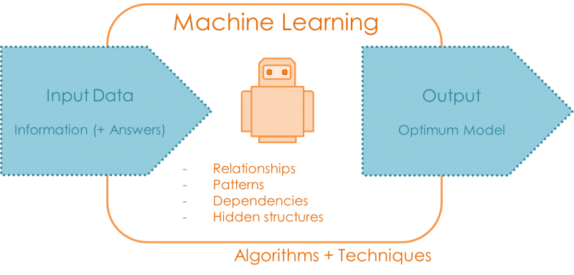



Problem
Gene expression varies across tissues
Obtaining samples from heart, lung, brain and other organs is often not possible
Goal
+
Algorithms + techniques
Al
Algorithms + techniques
Al
Image source: https://quantdare.com/
Notes:
The main problem that we are facing is that we need to assess new treatments corresponding to certain tissues, and to do so, we need to understand the gene expression of said tissues. However, obtaining samples from heart, lung, brain and other organs is often not possible without invasive procedure.
Therefore, the goal of this project is to develop a machine learning algorithm that can reliably predict gene expression in many different tissues when only gene expression measurements in whole blood are available.
Here the input data will be the gene expression from whole blood as well as from the other tissue that we wish to predict. Then the algorithm will learn about their relationships, patterns, dependencies, and hidden structures, and then it will give us an optimum model that we can use to do further prediction.

Slide 5
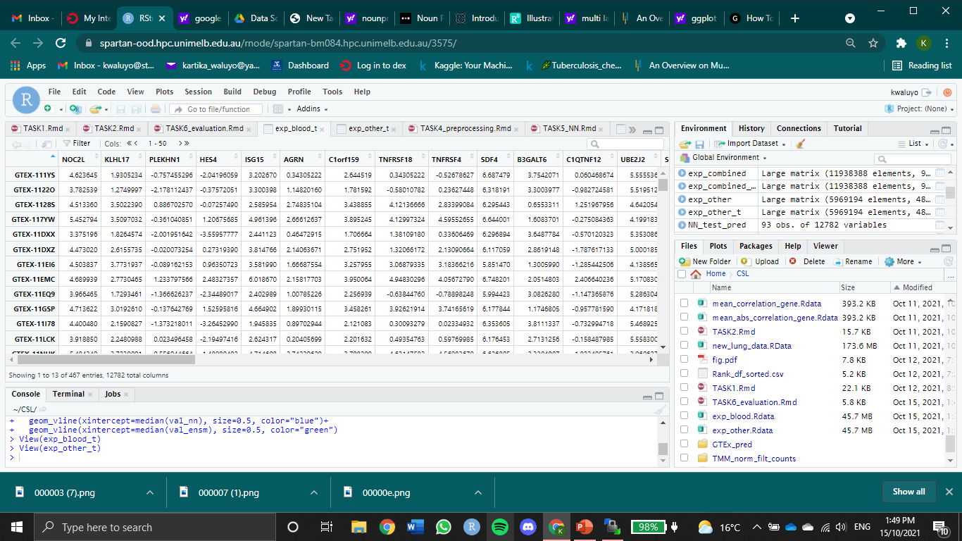
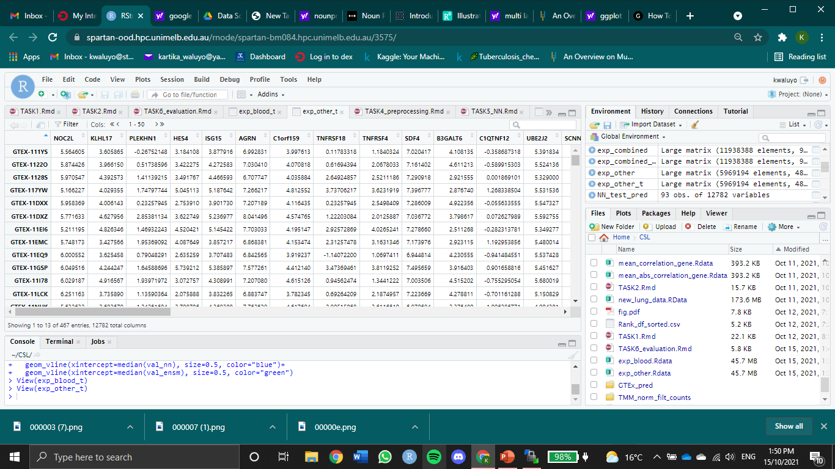
Data pre-processing
Notes:
To simplify the problem, for each tissue, we only keep the shared genes and shared donors with blood
Here’s a snapshot of how the data looks like. The columns are the donors and the rows are the genes.
Later on, the data will be transposed so the columns will be the genes and the rows will be the donors because in this context, the genes will be the explanatory variables and each donor will be treated as 1 individual sample

Slide 6
Preliminary Data Analysis
Summary of part 1
Exploration of similarities between each tissue and whole blood
Shared donors
Shared expressed genes
Gene expression correlation

Slide 7
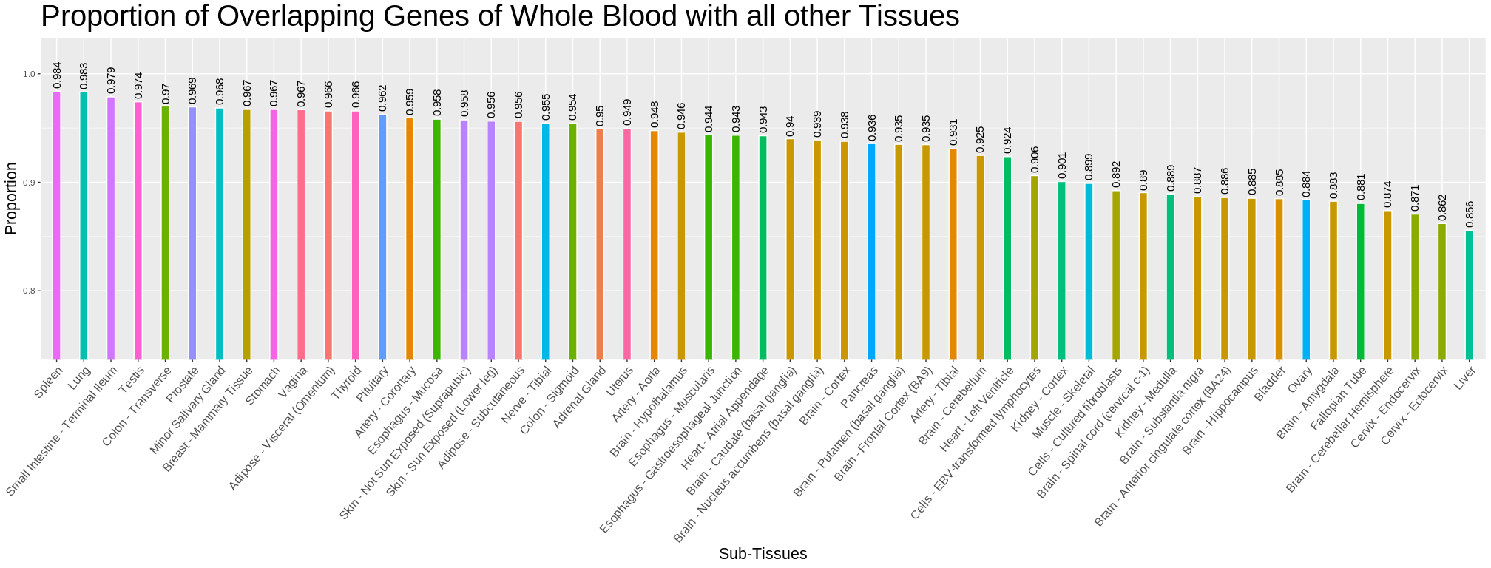
Notes:
The figure shows the proportion of shared genes of Whole Blood with all other tissues. The Spleen, Lung, and Terminal Illeum have the highest proportion of shared genes which are also found in Whole Blood. It gives us a picture of how similar each tissue with WB

Slide 8
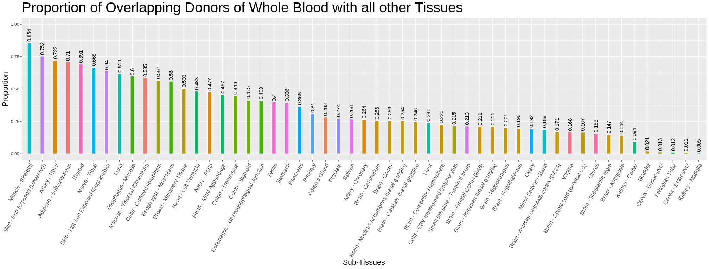
Notes:
The figure depicts the proportion of overlapping donors of Whole Blood in all other Tissues. Muscle – Skeletal, skin – sun exposed, and artery - tibial have the highest proportion of overlapping donors with Whole Blood. It gives us a picture of how many Whole Blood donors have also donated other tissues.

Slide 9
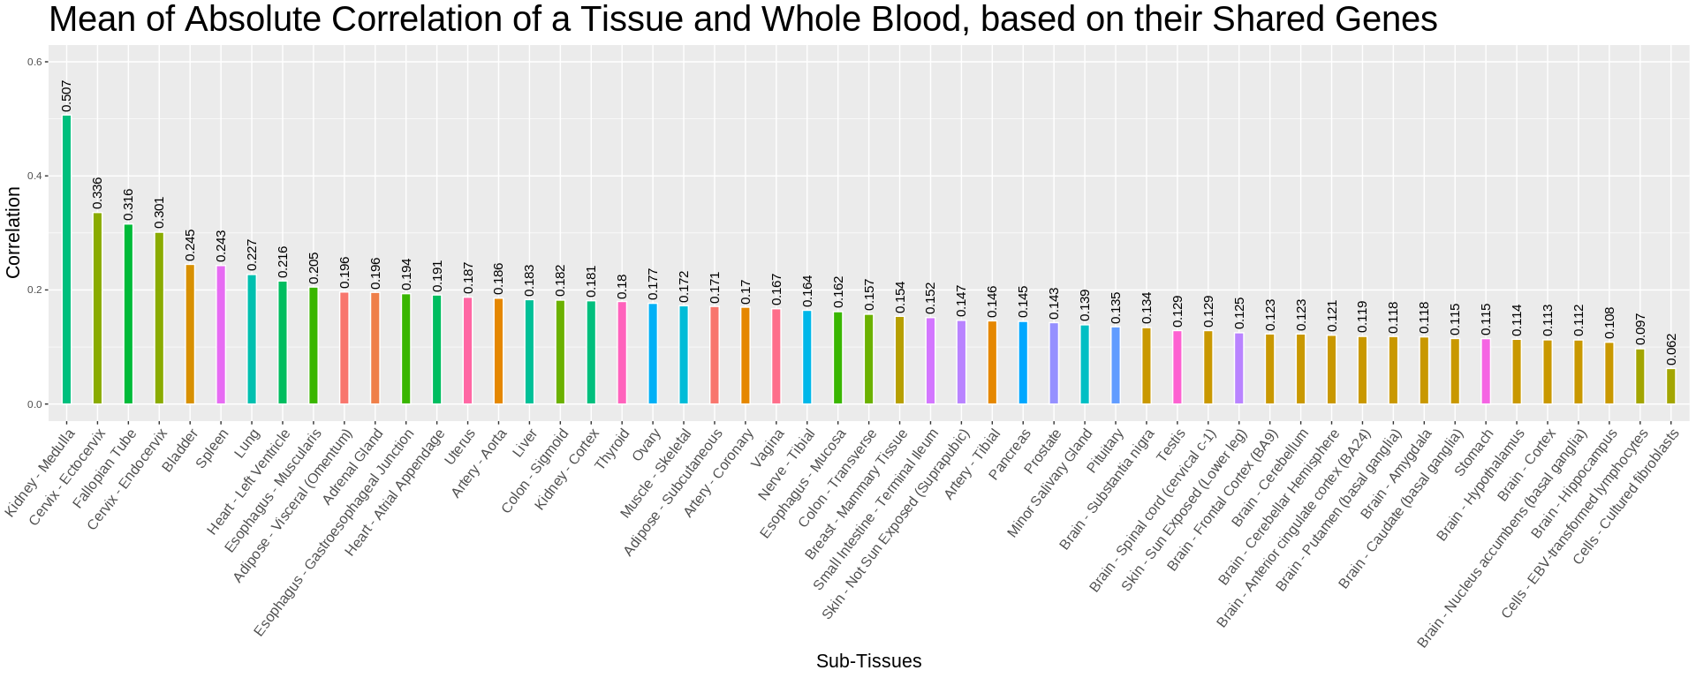
Notes:
The figure represents the mean of absolute correlation between a tissue and Whole Blood, based on their shared genes.
The absolute correlation is a measure that denotes the strength of the relationship between the tissue and Whole Blood, based on their shared genes, regardless of the direction. Here, kidney – medulla, cervix – ectocervix, and fallopian tube have the strongest relationship with whole blood

Slide 10
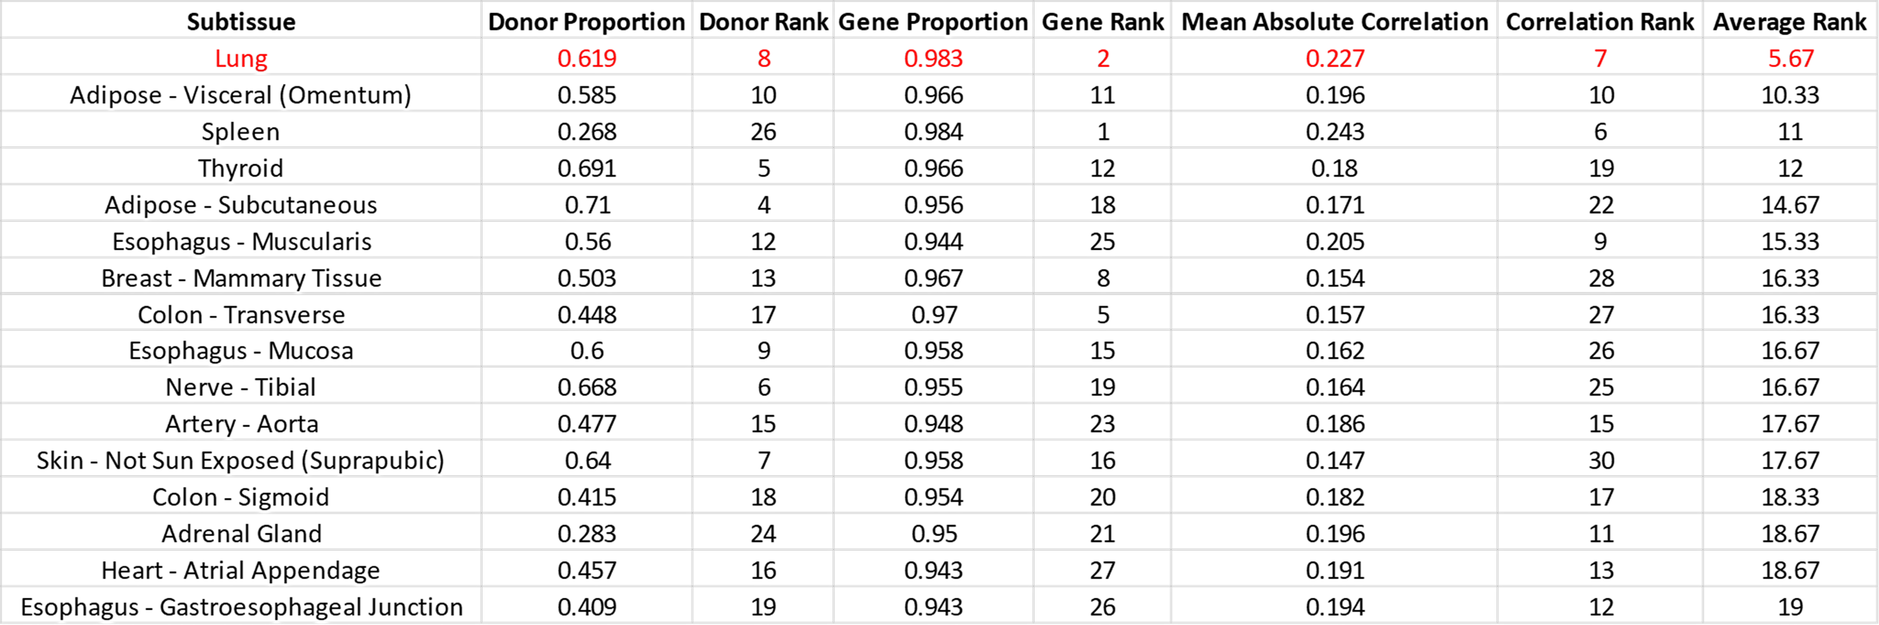
Tissue Selection
Rank tissues based on the previously observed measures
Notes:
We rank tissues based on three different measures:
proportion of overlapping donors: We want the tissue with a high proportion because it will give us a high training sample size
proportion of shared expressed genes
correlation between expression levels: We want the tissue with high proportion (2) and high correlation (3) because it will be the most similar tissue to WB
The rank per tissue per measure is averaged out to give us the final rank it holds.
We choose the tissue with the lowest average rank
Taking the tissue that is the easiest to train, from here we’ll only work with lung for trial purposes

Slide 11
Models
eXtreme Gradient Boosting
Neural Network
Ensemble Model

Slide 12

Cross-validation
80%
Test data
20%
374 samples
93 samples
Finding Parameters
Test data
Image source: https://scikit-learn.org/stable/modules/cross_validation.html
Notes:
For NN and XGB:
To assess the performance of the models we need a test set which is the unseen set, and a training set which will be used to train the model. For model selection we need a validation set, and in order to achieve randomness and unbiased result we did a cross validation.
First we split the data into training and test set 80:20
After that we split the training data into 5 folds
We train the models using training data
For hyperparameter tuning , we do a 5-fold CV
After that, we take the average evaluation measure from 5 iterations
Then choose the best hyperparameter combination and train all the training set using the best hyperparameter value
Finally, we evaluate it using the test set
For long presentation
Maybe explain about: 1st iteration use Fold1 as test set and Fold2-5 as training set, 2nd iteration use Fold2 as test set and Fold1,3-5 as training set, and so on

Slide 13
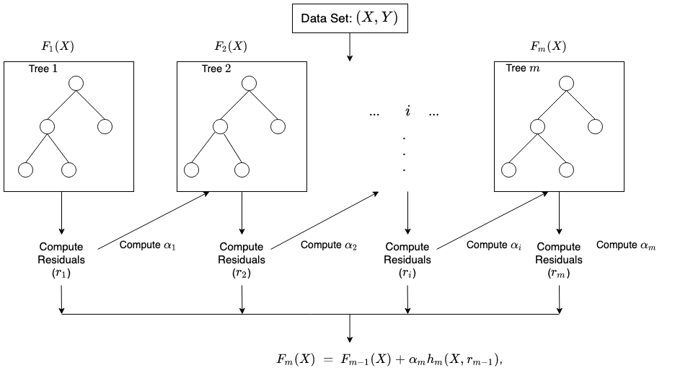
eXtreme Gradient Boosting (XGBoost)
Maximum Depth
Gamma
m
Image source: https://docs.aws.amazon.com/sagemaker/latest/dg/xgboost-HowItWorks.html
Eta
Notes:
Gamma: minimum loss reduction required to make a further partition on a leaf node of the tree.
Eta: learning rate
m : number of trees

Slide 14
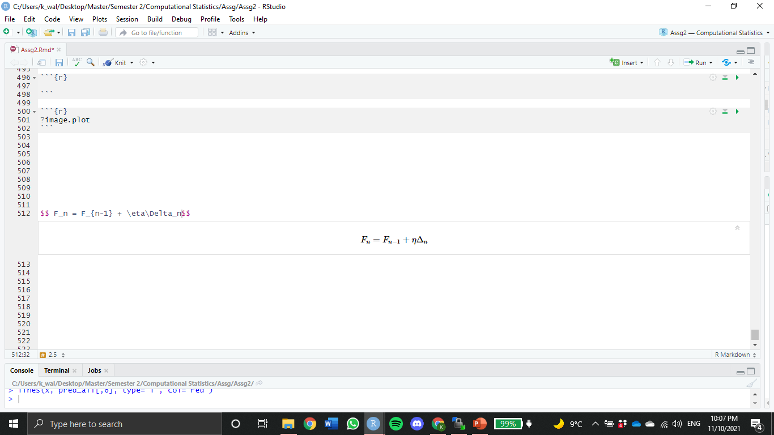
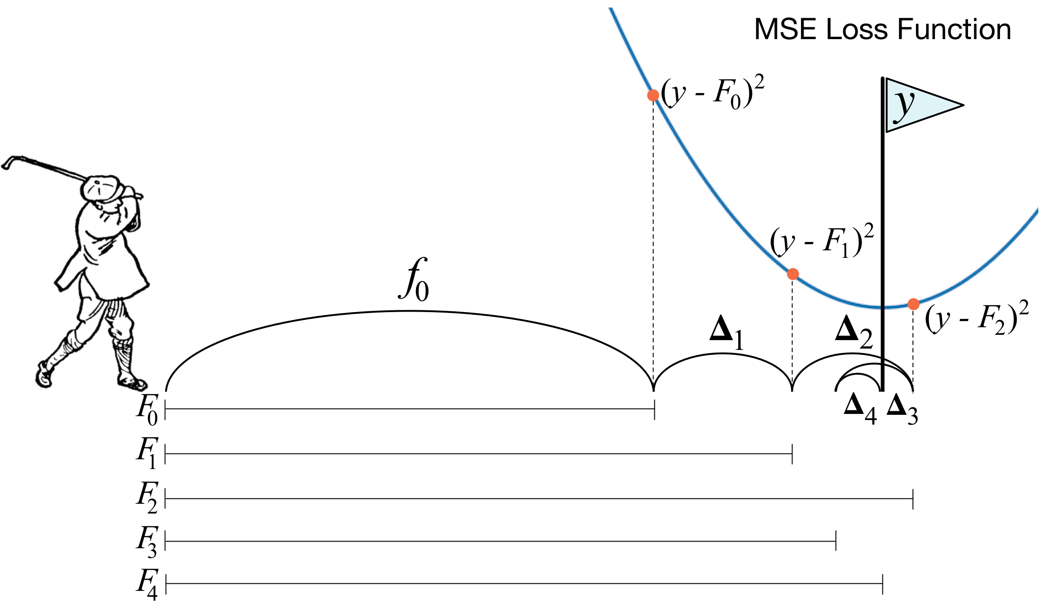
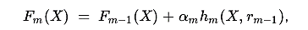
Gradient Boosting Machines (GBM)
Gradient Boosting approach is given by
Recall from previous slide
Eta
Residual
Image source: https://explained.ai/gradient-boosting/descent.html
Notes:
Gradient Boosting Machines (GBM)
Consider η=1, at each stage, GBM predicts the y - Fₙ₋₁ (residual or gradient of loss) which is difference of distance from pole to the golf ball
So, at every iteration, GBM tries to predict this distance, which is like golfer aiming for pole before each shot. And sometimes the ball can even cross the pole (like Δ₂), hence using the gradient descent, correct sign is applied when Δ is calculated.
So its recommended to use smaller η, such that the minima of loss or the pole isn’t missed.

Slide 15
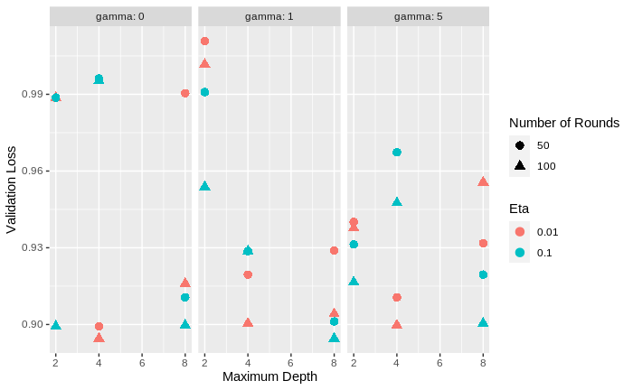
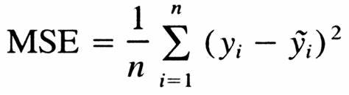
Hyperparameter Tuning
On 50 random genes
On gamma, maximum depth, eta, and number of rounds
Loss Function
Best hyperparameter combination:
Gamma = 1
Maximum depth = 8
Eta = 0.1
Number of rounds = 100
Notes:
We did a gridsearch to find the best hyperparameter combination using MSE as the loss function.
Hyperparameters being considered are:
Gamma
maximum depth
eta (learning rate)
number of rounds(number of trees)
Because the gridsearch took a very long time to run we only ran it using 50 random genes.
With 50 random genes it took approximately 10 hours.
After the best performance parameter were chosen, the model was trained again on all genes
Refer to the best parameter:
Complex model needs a quick training, otherwise it will overfit
For long presentation
Loss Function: The role of the loss function is to estimate how best is the model in making predictions with the given data.

Slide 16
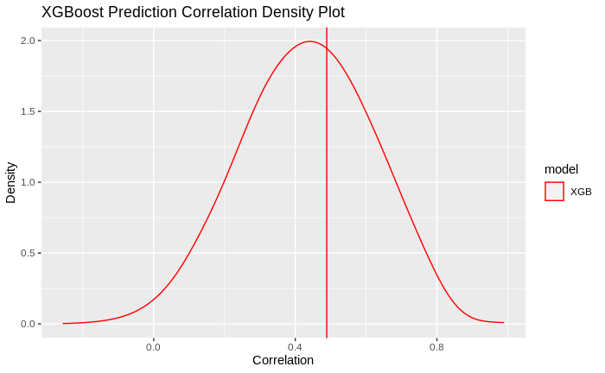
Evaluation
Compute the correlation between each gene in the prediction and its true value
Model | Median Correlation
Model | Training | Test
XGBoost | 0.990975 | 0.4364047
Neural Network
Ensemble
Notes:
We compute the correlation between each gene in the prediction and its true value
For training prediction, the median correlation is 0.99
And for test prediction, the median correlation is 0.43
The plot shows high density for positive correlation which means that high number of genes in lung have strong relationship with genes in whole blood

Slide 17
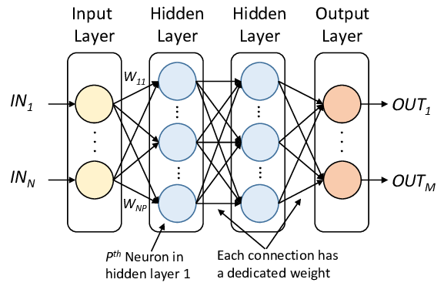
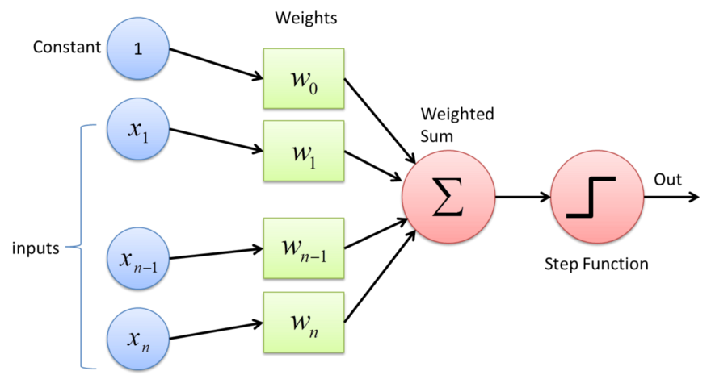
Neural Network
Multilayer perceptron
Perceptron
Single-layer neural network
Activation Function
Image source: https://www.norwegiancreations.com/2019/04/introduction-to-neural-network/
Image source: https://www.simplilearn.com/tutorials/deep-learning-tutorial/multilayer-perceptron
Notes:
The next model we built is NN
First we’ll take a look on the structure of a single-layer neural network or what’s called a perceptron
A perceptron is the building block of a NN. It takes in input, performs some form of computation on them and at last produces an output
As we see in the image above, for each sample, all the explanatory variables, x_{n}, are multiplied with their weights (and biases), w. Weights shows the strength of a particular neuron. Then, all the multiplied values are added together to something called a weighted sum, and the weighted sum is applied to a correct type of function and then we have the output.
Now extending a perceptron we have a multilayer perceptron or artificial neural network, and to simplify it we’ll just call it neural network
A NN has one or more hidden layers
And each connection between hidden layers has a weight
Training a NN entails finding the weights which minimize errors on the training data
We train a NN by iterating over samples in a training dataset
Input is the whole blood gene expression
Response is the lung gene expression
Activation function: relu for the hidden layers and linear for the output layer
For long presentation:
Each iteration over the whole dataset is called an epoch

Slide 18
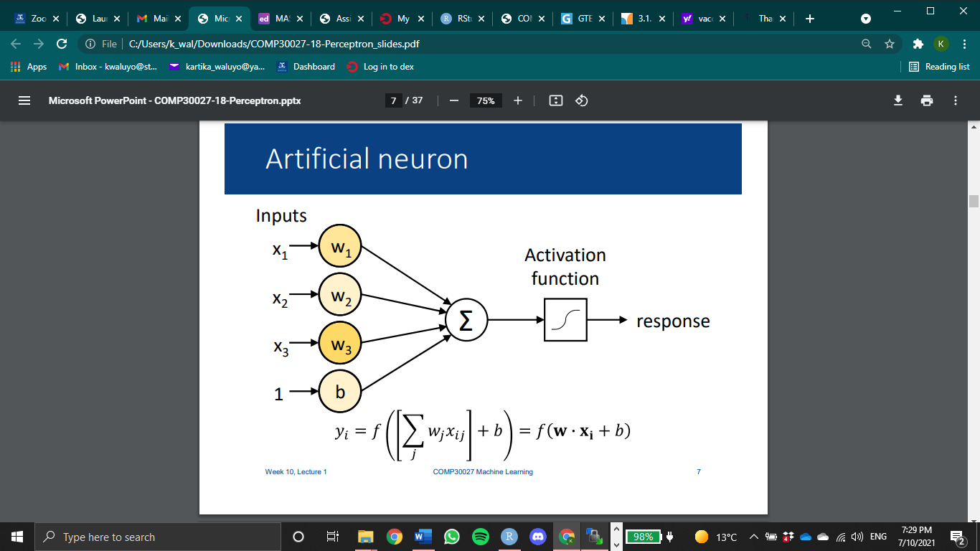
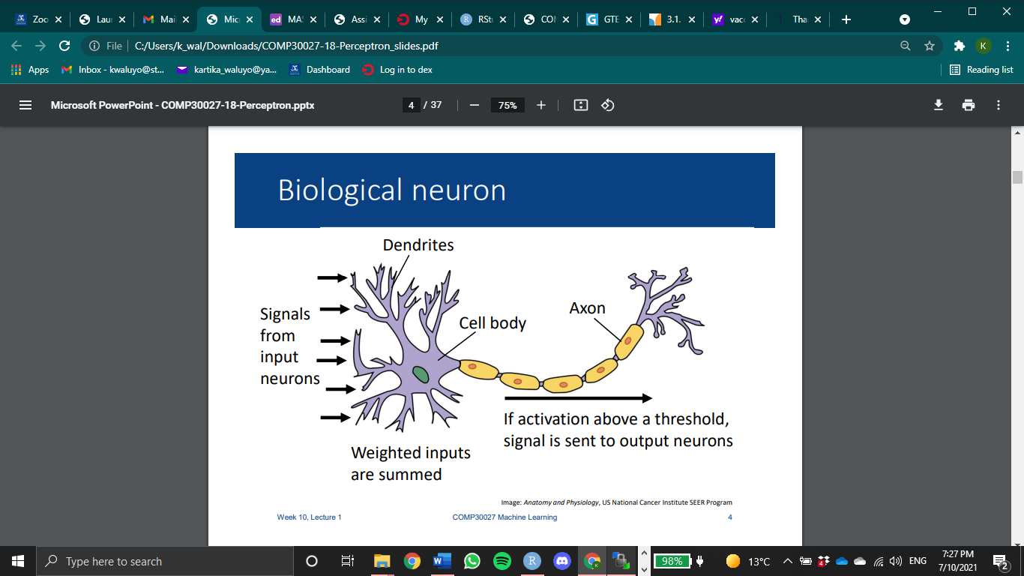
Neural Network
Biological Neuron
Artificial Neuron
Image Source: Anatomy and Physiology, US National Cancer Institute SEER Program
Image Source: The University of Melbourne COMP30027 Machine Learning Lecture, by Kris Ehinger
Notes:
The next model we built is NN
Training a NN entails finding the weights which minimize errors on the training data
We train a NN by iterating over samples in a training dataset
Input is the whole blood gene expression
Response is the lung gene expression
Activation function: relu for the hidden layers and linear for the output layer
For long presentation:
Each iteration over the whole dataset is called an epoch

Slide 19
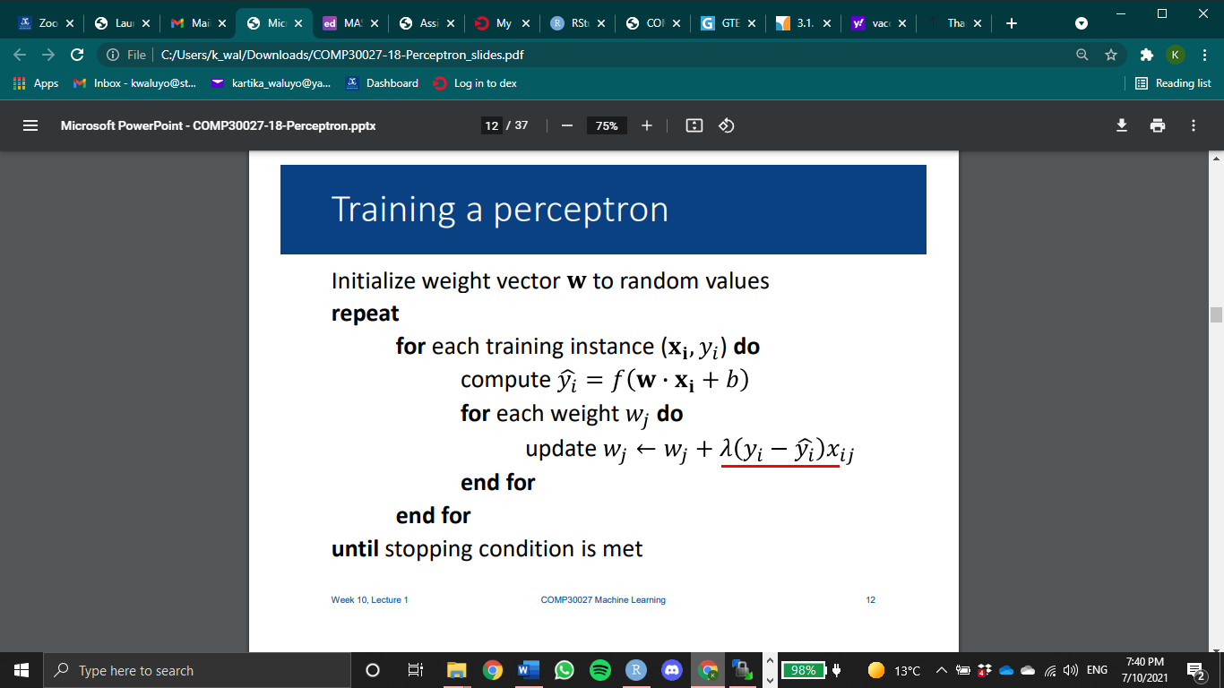
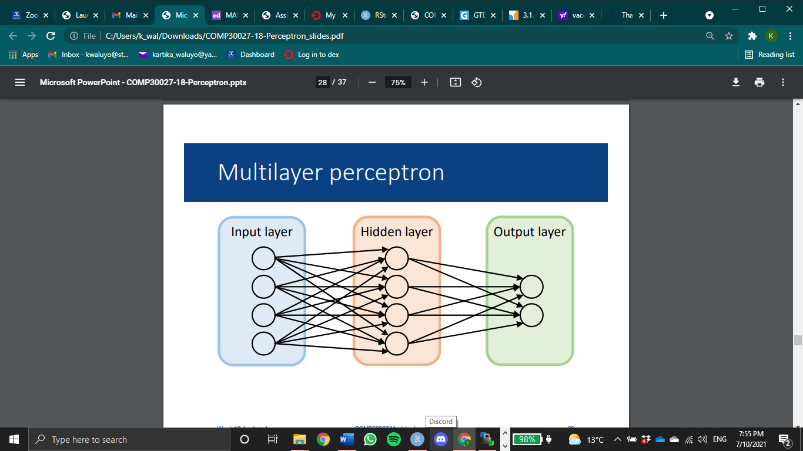
Algorithm
1 epoch
Backpropagation/gradient descent
Learning rate
High → big jump on the update
Notes:
Algorithm:
• For training examples, compute y based on current weights
• Update weights based on the difference between predicted y and true label
However,
Need to find correct weights for the output neuron(s), and all the neurons in the hidden layer
Can’t use the algorithm in the hidden layer – we don’t know what values these neurons are supposed to produce for the input
• There is no one set of “correct” values for this layer – multiple possible solutions
• Solution: backpropagation
Backpropagation:
• Form of gradient descent – iterative process for finding the weight parameters that minimize error
• Requires a learning rate → a hyper-parameter that controls how much we are adjusting the weights of our network with respect to the loss gradient
A too low learning rate never progresses, while a too high causes instability and never converges.
• Idea: look at the derivative of error and update weights in the direction that would reduce error
• Compute errors at the output layer w.r.t. each weight using partial differentiation
• Propagate errors back to each of the earlier layers

Slide 20
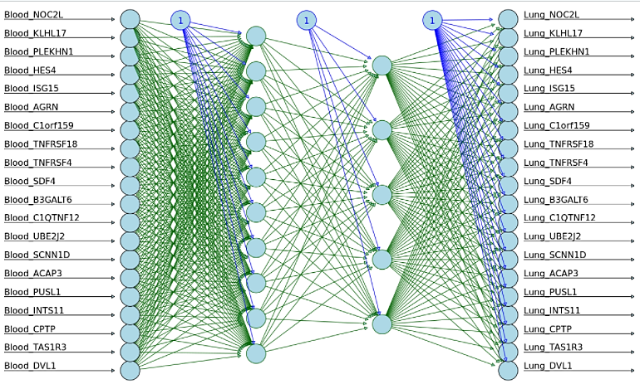
Neural network illustration
Input
1st hidden layer
2nd hidden layer
Output

Slide 21
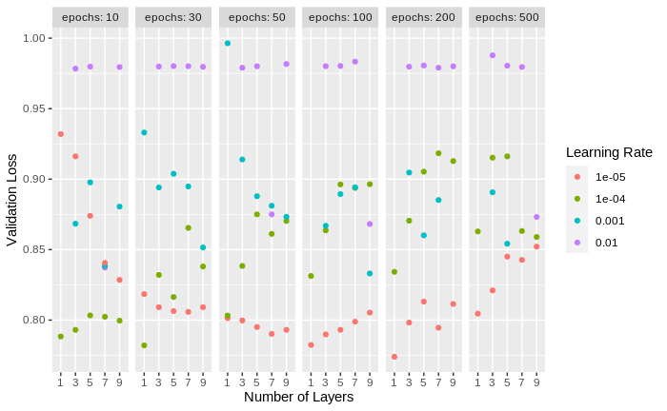
Hyperparameter Tuning
On number of layers, learning rate, and number of epochs
Loss Function
Best hyperparameter combination:
1 hidden layer of 100 units
Learning rate = e⁻⁵
Epochs = 200
Notes:
Similar to what we did with xgboost we did a gridsearch
On number of layers, learning rate, and number of epochs
Here we can observe that when learning rate is1 to the minus 5, there’s a clear pattern happening (pink).
For low epoch, 10, 30 and 50, the loss decrease as the number of layers increase. However when epoch is 100, 200 and 500 the loss increase along with the number of layers. This makes sense because a quick training or low epoch training needs deeper and wider model to fit more nicely. However, when it’s a high epoch training, if we train a deep or wide model it will overfit.

Slide 22
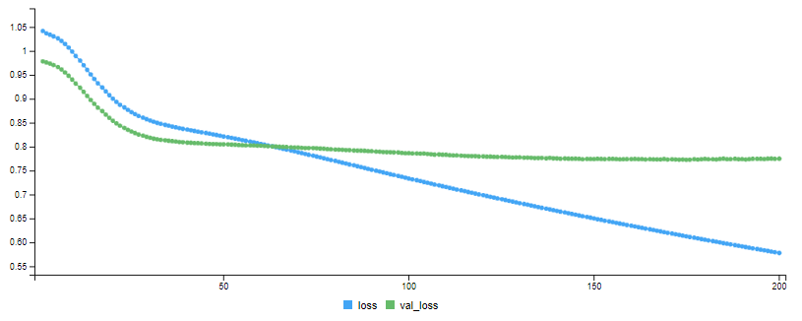
Result
Train and validation MSE, using the best model
MSE
Validation MSE

Slide 23
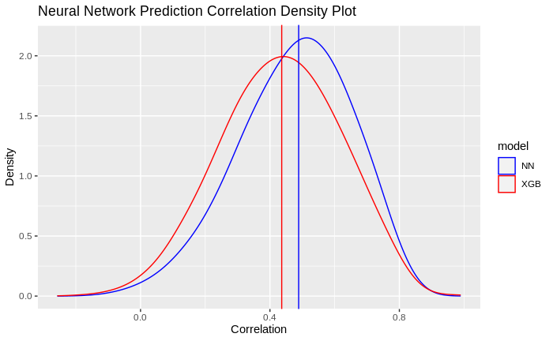
Evaluation
Compute the correlation between each gene in the prediction and its true value
Model | Median Correlation
Model | Training | Test
XGBoost | 0.990975 | 0.4364047
Neural Network | 0.6278658 | 0.4887672
Ensemble
Notes:
For training prediction, the median correlation is 0.63
And for test prediction, the median correlation is 0.489
There’s a slight improvement on the correlation
Here we can observe that although the training correlation for NN is much lower than xgboost, but the test correlation is higher
This might happen because the xgboost model overfits

Slide 24
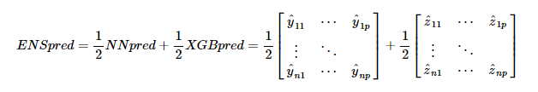
Ensemble model
Notes:
Next, as a proof of concept, we create the most simplistic version of the ensemble prediction. We take the average of the NN and XGB prediction

Slide 25
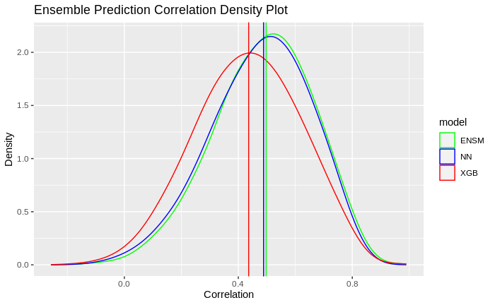
Evaluation
Compute the correlation for each gene in the prediction and the true value
Model | Median Correlation
Model | Training | Test
XGBoost | 0.990975 | 0.4364047
Neural Network | 0.6278658 | 0.4887672
Ensemble | 0.9205496 | 0.4976427
Notes:
For training prediction, the median correlation is 0.92
And for test prediction, the median correlation is 0.498
Here we can see that the ensemble prediction’s correlation is higher than both NN and XGB.
This can be a basis for a more advanced ensemble model in the future where another model can be trained

Slide 26
Future Directions
Training the models on all other tissues, on the entire dataset
Stacking ensemble for improved prediction
Biological validation
Implementation of the web application

Slide 27
We would like to extend a heartfelt thank you to all our mentors involved in this project!
Dr. Roberto Bonelli, CSL Research
Dr. Brendan Ansell, WEHI
Dr. Milica Ng, CSL Research
Dr. Monther Alhamdoosh, CSL Research
Dr. Melanie Bahlo, WEHI
Dr. Ziad Al Bkhetan, The University of Melbourne
Dr. Michael Kirley, The University of Melbourne

Slide 28
Question ?

Slide 29
THANK YOU

